Slide 1
CONTROL SYSTEM OVERVIEW
By Dr. L.Umanand, CEDT, IISc

Slide 2
Why Closed loop control?
    Increased bandwidth
    Reduced steady state errors
    Reduced system sensitivity to parameter changes and output disturbances
    Shaping of the time response
    Stability of unstable open loop systems

Slide 3
What are control requirements?
SSS Requirement
    Stability
    Steady state accuracy
    Speed of response

Slide 4
STABILITY
ASYMPTOTIC STABILITY
MARGINAL STABILITY
BIBO STABILITY
Demo in “control1.mdl”

Slide 5
STABILITY METHODS
    Partial fractions
    Routh Hurwitz criterion
    Root locus
    Nyquist criterion
    Frequency response plots
OBSOLETE

Slide 6
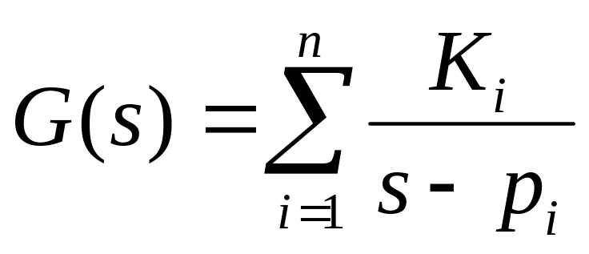
Partial Fraction Method

Slide 7
Routh Hurwitz Criterion
    Routh Hurwitz method does not involve factorising the characteristic polynomial.
    Hurwitz test: A necessary condition for asymptotic stability is that all coefficients of the characteristic polynomial must have the same sign and none may be zero.
    Routh criterion: The number of roots in the right half of s-plane is equal to the number of sign changes in the first column of the Routh table.

Slide 8
Root Locus Method
R(s)
Y(s)
+
G
-
H

Slide 9
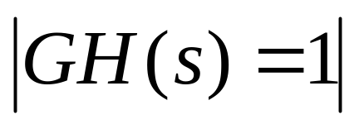
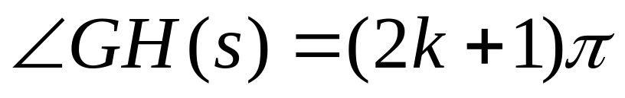
Root Locus Method
Characteristic equation = 1+ GH
=> GH = -1
where k = 0, +/-1, +/-2,…

Slide 10
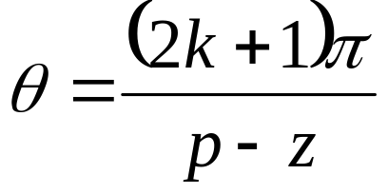
Root Locus Construction
Starting and Ending points
Root locus segments on the real axis
imaginary axis intersections
Asymptotes
where p and z are the number of finite poles and
finite zeros respectively of GH(s)
Demo in “control2.m”

Slide 11
Nyquist Criterion
F(s) = 1 + GH(s)
As a point s moves around a closed contour in the s-plane,
there result a definite number of encirclements (N) of the
origin in the F(s)-plane. The net number of encirclements of
the origin by the mapping of the closed s-plane contour into
the F(s)-plane is equal to the number of zeros (Z) minus the
number of poles (P) of F(s) inside the closed s-plane contour.
N = Z - P

Slide 12
Steps for Nyquist method
Determine the number of open loop poles in the right half s-plane (P)
Sketch Bode magnitude and phase diagrams of GH(jω)
Sketch the polar plot in the GH(jω)-plane

Slide 13
Steps for Nyquist method..
Determine the net number of encirclements (N) of the –1+j0 point where N is positive if the encirclements are in the same direction as the s-plane contour and negative if the direction is opposite.
Compute Z=N+P, where Z is the number of right half s-plane closed loop poles. System is stable if Z is zero.
Demo in “control3.m”

Slide 14
Frequency Response plots
Bode plot (magnitude and phase in different plots)
Nichols plot (magnitude and phase in the same plot)
Demo of bode in “control2.m” and “control3.m”

Slide 15
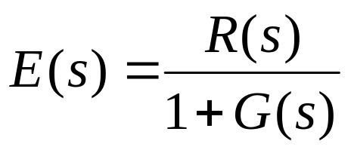
Steady State Accuracy
R(s)
E(s)
Y(s)
+
G(s)
-

Slide 16
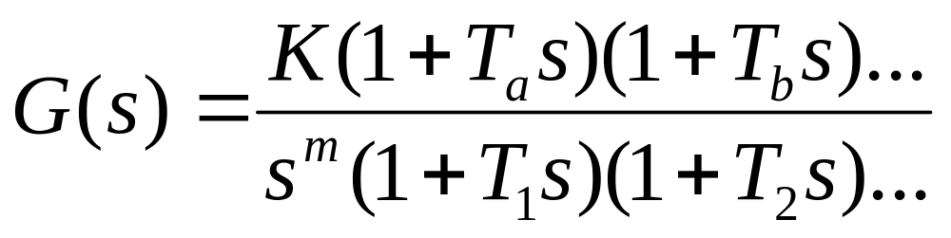
Steady State Accuracy
System
TYPE

Slide 17
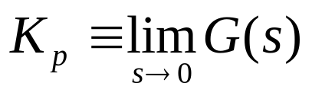
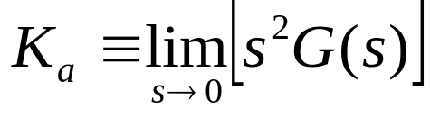
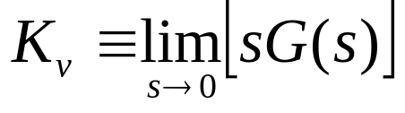
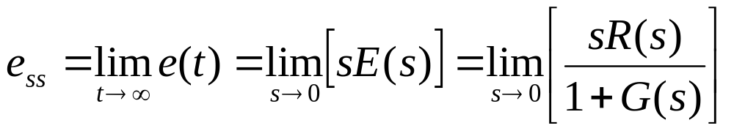
Error Constants

Slide 18
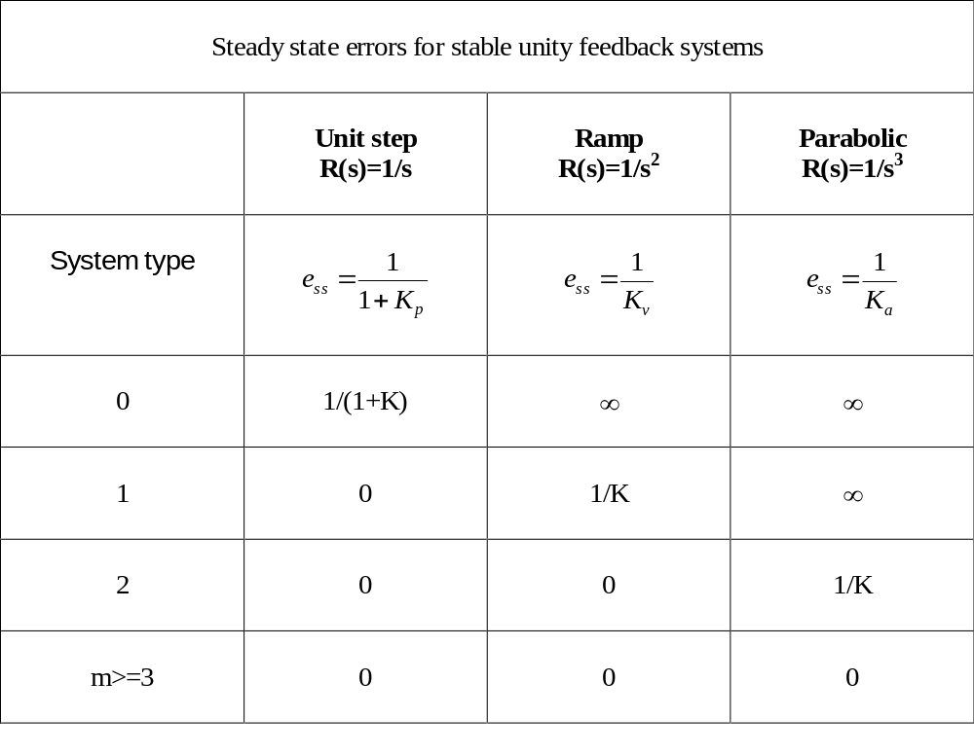

Slide 19
Speed of Response
What is speed of response?
How to choose the controller gain?
How to choose the controller?
Demo in “control4.m”

